Slide 1
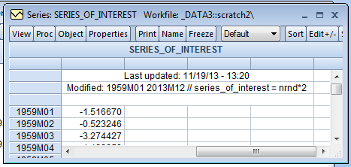
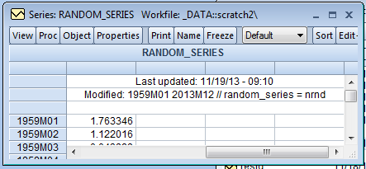
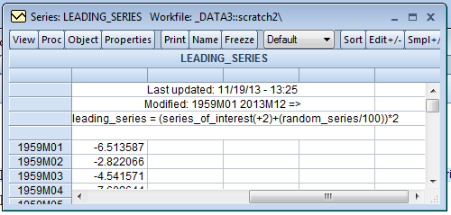
Three series –
  Series of Interest (SoI)
  Leading Series (LS) which describes 2nd lead of SoI nearly perfectly
  Random series (RS) which is used to add sufficient error to the LS such that the required matrices are invertible
(series definitions)

Slide 2
All three series are normally distributed
Jarque-Bera Test Null Hypothesis:
Distribution is Normal
(fail to reject a normal
distribution in all three cases)

Slide 3
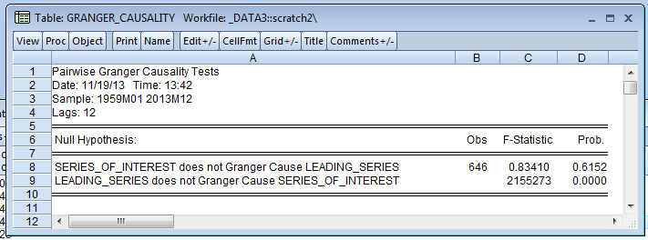
Granger Causality Test Results:
We reject that Leading_Series does not Granger Cause Series_Of_Interest, i.e. we assume there is a directional relationship moving from Leading_Series to Series_Of_Interest
We fail to reject that Series_Of_Interest does not Granger Cause Leading_Series, i.e. we assume there is not a directional relationship moving from Series_Of_Interest to Leading_Series
Net net: We can say that Leading_Series moves before Series_Of_Interest

Slide 4
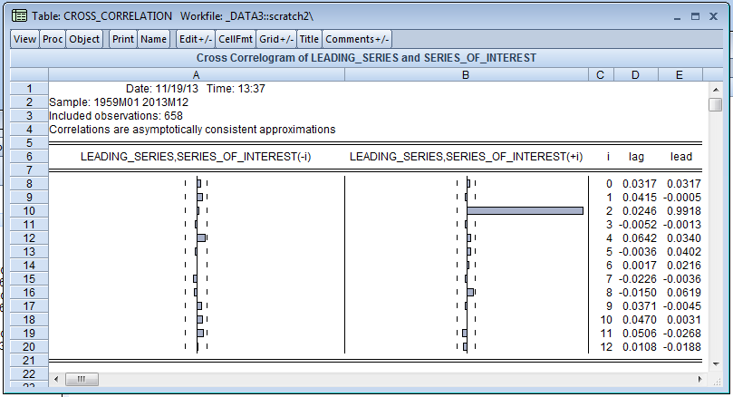
Cross Correlation Results:
Leading_Series leads Series_of_Interest by 2 periods
All other leads & lags are statistically insignificant
Net net: Leading_Series moves 2 periods before Series_Of_Interest

Slide 5
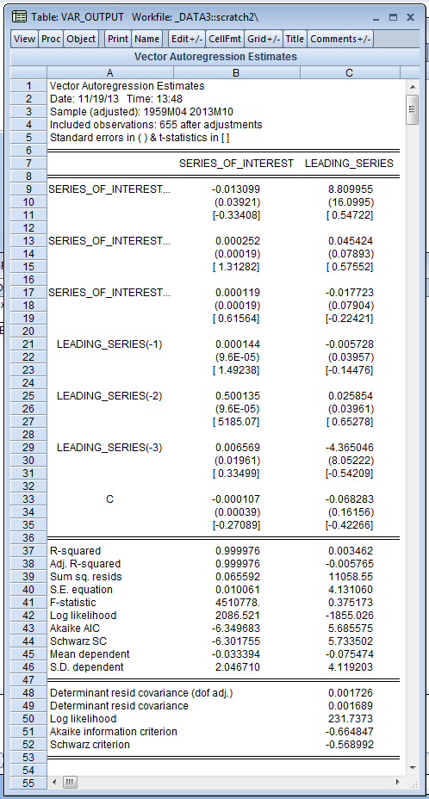
VAR Model
Only the 2nd lag of Leading_Series is statistically
significant at the 95% confidence level or better and it describes
Series_of_Interest near perfectly
Critical value of t: 1.96

Slide 6
Impulse Response:
A one Standard Deviation (SD) shock to Leading_Series leads to a positive 2.07 UNIT movement in Series_of_Interest; effects in all other periods are statistically
2.07

