Slide 1
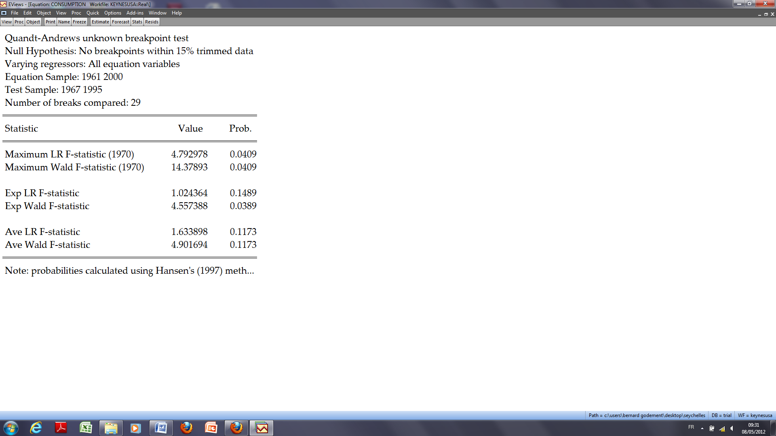
These probabilities cannot be identical.

