Slide 1
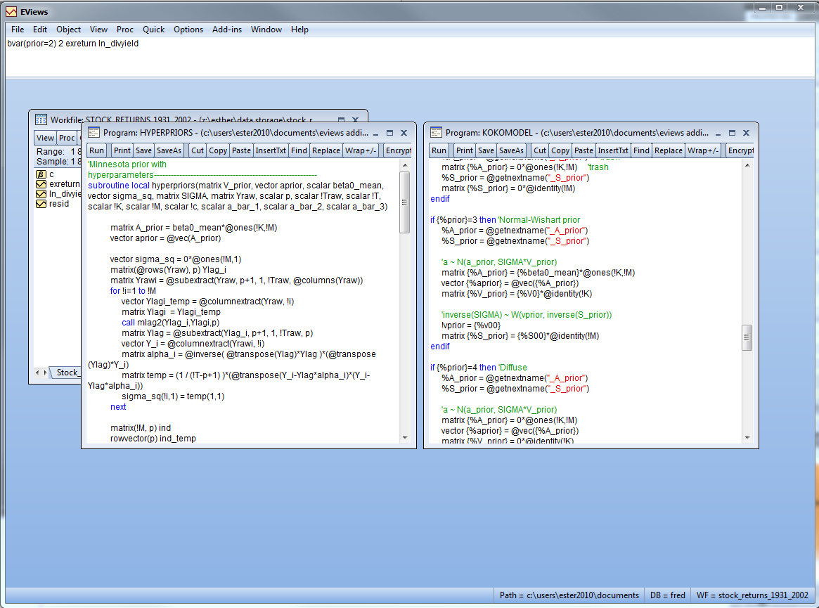
Open the following two programs: hyperpriors and kokomodel. These programs are available in your EViews addins directory.

Slide 2
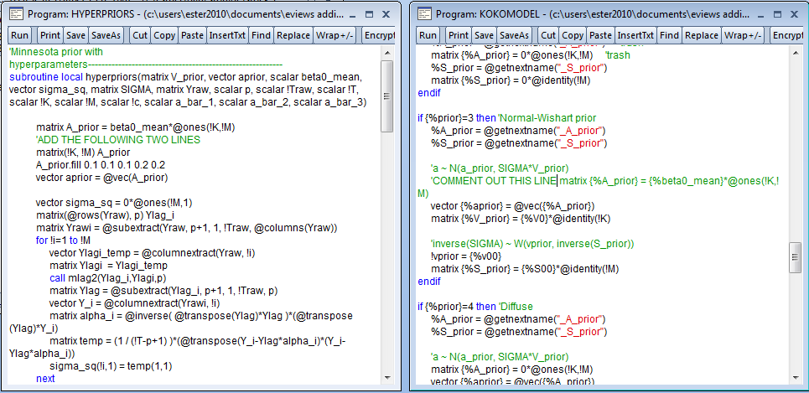
Fill the K(=Mp+1) by M matrix A_prior with the values (e.g. 0.1 0.1 0.1 0.2 0.2) we would like to use.

